Slide 1
Programming for Image Processing/Analysis and Visualization using
The Visualization Toolkit
Week 5: Image Manipulation and Display
http://noodle.med.yale.edu/~papad/seminar/
Man Pages etc: http://noodle.med.yale.edu/tcl
and http://noodle.med.yale.edu/vtk/
Xenios Papademetris
papad@noodle.med.yale.edu
BML 325, 5-7294

Slide 2
Revised Schedule for Part 1
Introduce VTK (9/3)
Introduce Tcl/Tk(9/10)
Simple Visualization Tasks (9/17)
Surface and Image Manipulation (9/23)
Image Manipulation and Display(10/1)
Local Extensions (10/8)
Tk and GUIs (10/15)
[Incr] Tcl and other extensions (10/22)

Slide 3
Revision -- VTK Pipeline (I)
File Output
Sources
Filters
Mappers
Props
vtkDataSet
vtkDataSet

Slide 4
Data Representation
(vtkDataSet)
Point Attributes
(vtkPointData)
Point Properties
(e.g. intensity)
Points
(vtkPoints)
Define Location
Arrays of
Numbers
(one per point
or cell)
vtkDataArray
Data Set
Cells
(vtkCellArray)
Define Topology
Cell Attributes
(vtkCellData)
Cell Properties
(e.g. normal)

Slide 5
Images are Simpler
Point Attributes
(vtkPointData)
Point Properties
(e.g. intensity)
Points
(vtkPoints)
Define Location
Arrays of
Numbers
(one per point
or cell)
vtkDataArray
vtkImageData
Cells
(vtkCellArray)
Define Topology
Cell Attributes
(vtkCellData)
Cell Properties
(e.g. normal)
Implicitly Defined by Image Specification
Rarely Used

Slide 6
vtkImageData
vtkImageData is the basic VTK class for storing images.
It is defined by 4 key elements
  Dimensions -- these define the size of the image
  Origin -- the position in 3D space of point 0 0 0
  Spacing -- the voxel dimensions
  Scalar Type -- the type of the image (e.g. float, short etc)
An 4x4x4 image has 4x4x4=64 points and 3x3x3=27 cubic cells (both are implicitly defined)

Slide 7
Visualizing Images
Images are displayed as textures mapped on polygons, uses special feature (texture memory) on most decent (>$75) graphics boards.
In OpenGL all textures must have dimensions that are powers of two
Images are interpolated before display, hence some (small) loss of sharpness takes place (only visible in small images)
  E.g. an 100x50 image will be resampled to 128x64 before display
Similar issues for color display i.e. scalars vs lookup tables as in surfaces
We will examine image display next week!

Slide 8
An Aside: Imaging Conventions
Images are 3D Functions with proper X,Y,Z axes
Caveats:
  Radiologists are used to looking at images in certain orientations regardless of underlying axes
  Images can be acquired in one of three (excluding obliques) orientations: Axial, Coronal and Sagittal, the X,Y,Z axes depend on the acquisition protocol (All non-MR are usually acquired using axial orientation)
  Images are typically left/right flipped (radiology convention – looking from the feet up!)
  Neurosurgery applications require proper left/right orientation
  Brain is mostly left/right symmetric, really easy to make very costly mistakes

Slide 9
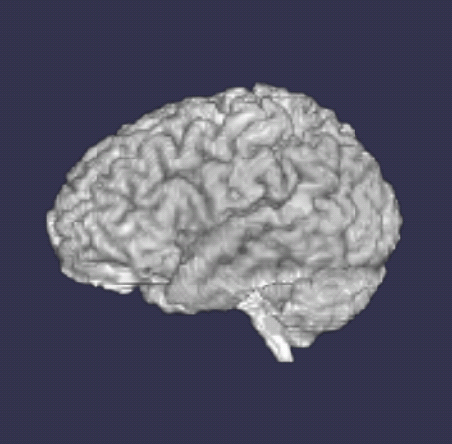
Image Acquisition Orientations
Axial(0) – Bottom to Top
Sagittal(2) – Left to Right
Coronal(1) – Front to Back

Slide 10
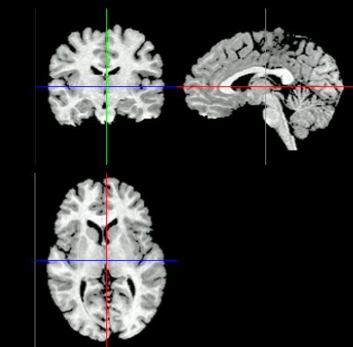
Imaging Slices
Coronal
Sagittal
Axial
The slices should look the same regardless of the original acquisition orientation!

Slide 11
Display Problems
If the images are displayed in 3D space as they are acquired they look wrong!
The contrast of some images can be bad!
If the images are reformatted to look right
  we loose track of the original data locations
  often this is not possible for all three types of planes
  images are often acquired using the wrong slice order
(My adopted) Solution
  Ensure slice order adheres to predefined protocol, if not flip the slice order (this is the only modification to the original data)
  Preserve original data and perform ‘camera’ acrobatics in 3D to make them look right
  Use lookup tables to adjust the contrast, but never modify the original intensities.

Slide 12
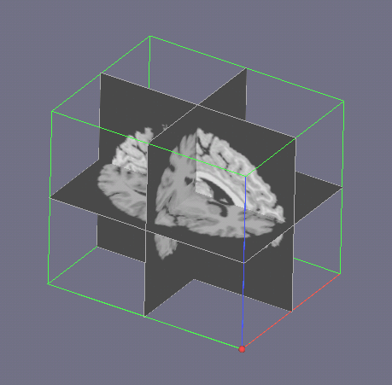
A 3D View (Axial Acquisition)
Coronal XZ
Sagittal YZ
Z
Z-axis
Z
X
Y
Axial XY
Y
Y-axis
X-axis

Slide 13
(Neuro)--Imaging Planes and Origins
(defining these took a month!)
 | Axial Slice | Coronal Slice | Sagittal Slice
Axial Acquisition | XY (Top Left) | XZ (Bot Left) | YZ (Bot Left)
Coronal Acquisition | XZ (Top Left) | XY (Top Left) | ZY (Top Left)
Sagittal Acquisition | ZX (Top Right) | ZY (Bot Right) | XY (Bot Left)
Plane numbering: YZ->Constant X (0), XZ -> Constant Y (1), XY -> Constant Z (2)

Slide 14
Back to VTK
All of the above conventions are crucial when users interact with imaging data
The conventions are adhered to in the specialized viewers that we will discuss next week as part of the local extensions.
For the rest of the talk we will ignore most of the preceding material and just display the raw images themselves

Slide 15
Image Data
This is a dummy slide to make available
links for downloading the images used in the
examples of this presentation.
2D Tiff Image
  examples\brain.tif
3D low-resolution brain image in VTK internal format
  examples\brain.vt

Slide 16
Reading an Image From a File
Typical command structure
Create Image Reader
  vtkTIFFReader tf
Set the filename
  tf SetFileName brain.tif
Load the image [ explicit execution, not always necessary]
  tf Update

Slide 17
A 10-line Image Viewer examples\example5_1.tcl
vtkTIFFReader tr
tr SetFileName brain.tif
tr Update
vtkImageViewer vw
vw SetInput [ tr GetOutput ]
vw SetZSlice 0
vw SetColorLevel 128
vw SetColorWindow 255
vw Render
wm withdraw .
vwait forever
ColorLevel
Output Intensity
Input
Intensity
ColorWIndow
SetZSLice selects slice for 3D datasets

Slide 18
Adding a Smoothing Filter examples\example5_2.tcl
vtkTIFFReader tr
tr SetFileName brain.tif
vtkImageGaussianSmooth smooth
smooth SetInput [ tr GetOutput ]
smooth SetStandardDeviations 3 3 3
vtkImageViewer vw
vw SetInput [ tr GetOutput ]
vw SetZSlice 0
vw SetColorLevel 128
vw SetColorWindow 255
vw Render
wm withdraw .; vwait forever

Slide 19
Adding an Image Flip Filter examples\example5_3.tcl
vtkTIFFReader tr; tr SetFileName brain.tif
vtkImageGaussianSmooth smooth
smooth SetInput [ tr GetOutput ]
smooth SetStandardDeviations 3 3 3
vtkImageFlip flip
flip SetInput [ smooth GetOutput ]
flip SetFilteredAxis 1
vtkImageViewer vw
vw SetInput [ tr GetOutput ]
vw SetZSlice 0;
vw SetColorLevel 128; vw SetColorWindow 255
vw Render
wm withdraw .; vwait forever

Slide 20
Displaying Image Animation examples\example5_4.tcl
vtkStructuredPointsReader tr; tr SetFileName brain.vt
vtkImageMagnify magn; magn SetMagnificationFactors 4 4 1
magn SetInput [ tr GetOutput ]
vtkImageGaussianSmooth sm; sm SetInput [ magn GetOutput ]
sm SetStandardDeviations 3 3 3
vtkImageFlip flip; flip SetInput [ sm GetOutput ]
flip SetFilteredAxis 1
vtkImageViewer vw; vw SetInput [ flip GetOutput ]
vw SetColorLevel 240; vw SetColorWindow 256; vw Render
set dim [ [ tr GetOutput ] GetDimensions ]
set numslices [ lindex $dim 2 ]
for { set i 0 } { $i < $numslices } { incr i } {
puts stdout "Displaying slice $i/$numslices"
after 100;
vw SetZSlice $i; vw Render
}
exit

Slide 21
A Seven Line File Converter examples\example5_5.tcl
Convert TIFF to JPEG
vtkTIFFReader tr
tr SetFileName brain.tif
vtkJPEGWriter jp
jp SetInput [ tr GetOutput ]
jp SetFileName brain.jpg
jp Write
exit

Slide 22
Texture Mapping – the Pipeline
vtkPlaneSource
(generates 2D Plane
to map image to)
Mapper
vtkPolyDataMapper
vtkActor
Image Source
Extract Slice
vtkExtractVOI
Create Texture
vtkTexture
Generate
vtkLookupTable
for Mapping
colors

Slide 23
Texture Mapping I – Displaying the Plane
vtkPlaneSource imageplane
imageplane SetXResolution 1
imageplane SetYResolution 1
imageplane SetOrigin -0.5 -0.5 30
imageplane SetPoint1 40.5 -0.5 30
imageplane SetPoint2 -0.5 46.5 30
vtkPolyDataMapper map
map SetInput [ imageplane GetOutput ]
vtkActor imactor
imactor SetMapper map
vtkRenderer ren
ren AddActor imactor

Slide 24
Texture Mapping II – Displaying the Plane examples\example5_6.tcl
vtkRenderWindow renwin
renwin AddRenderer ren
renwin SetSize 300 300
ren ResetCamera
renwin Render
# Interactor
vtkRenderWindowInteractor iren
iren SetRenderWindow renwin
iren Initialize
iren AddObserver SetExitMethod { exit }
wm withdraw .; vwait forever

Slide 25
Texture Mapping III – Texturing the Plane examples\example5_7.tcl
vtkStructuredPointsReader tr
tr SetFileName examples/brain.vt
tr Update
vtkExtractVOI voi
voi SetInput [ tr GetOutput ]
voi SetVOI 0 41 0 47 30 30
vtkTexture texture
texture SetInput [ voi GetOutput ]
texture InterpolateOn
……
imactor SetTexture texture
Extract A Slice
Create
Texture
Apply
Texture

Slide 26
Texture Mapping IV – Adding a Colormap examples\example5_8.tcl
vtkLookupTable colormap
colormap SetNumberOfColors 256
colormap SetTableRange 0 255
for { set i 0 } { $i < 256 } { incr i } {
set v [ expr $i /255.0 ]
colormap SetTableValue $i $v $v $v 1.0
}
vtkTexture texture
texture SetInput [ voi GetOutput ]
texture InterpolateOn
texture SetLookupTable colormap
A 256
Color
Grayscale
Colormap
V=i/255.0
Apply
Colormap

Slide 27
Texture Mapping V – An Axial Slice examples\example5_9.tcl
Replace (Note Coronal = XY, Axial = XZ)
imageplane SetOrigin -0.5 -0.5 30
imageplane SetPoint1 40.5 -0.5 30
imageplane SetPoint2 -0.5 46.5 30
with
imageplane SetYResolution 1
imageplane SetOrigin -0.5 24 -0.5
imageplane SetPoint1 -0.5 24 52.5
imageplane SetPoint2 40.5 24 -0.5
and
voi SetVOI 0 41 0 47 30 30
with
voi SetVOI 0 41 24 24 0 53

Slide 28
Texture Mapping IV – Mapping to a Sphere examples\example5_10.tcl
Texture Mapping is a general technique for mapping textures(images) to polygonal data
Non-planar images require proper texture coordinates to be generated
See example for mapping an image to a sphere!

Slide 29
Volume Rendering
Volume Rendering is a method for direct rendering of images without mapping to an underlying geometrical object.
Lots of different methods
  key graphics element is transparency, often lower intensities are made more transparent to reveal higher intensities behind them in space
We will look at
  Ray-casting, generating 2D images from 3D using an X-ray like technique
  Volume Texture Mapping

Slide 30
Ray Casting
Set of
Rays
(need not be
parallel)
3D Object
2D Image formed by e.g.
Integral of
F(intensity) x G(transparency)
along each ray
Major Difficulty: Selection of Intensity and Transparency Transfer Functions F,G, this is highly data dependent.

Slide 31
Ray Mapping – the Pipeline
vtkVolumeRay
CastFunction
(generates line
integration
procedure)
Mapper
vtkColumeRayCastMapper
vtkVolume
Ensure Unsigned Char
Or Short Texture
vtkImageCast or
vtkImageShiftScale
Image Source
Create Volume
Property
vtkVolumeProperty
Generate opacity transfer
function using
vtkPiecewiseFunction
Generate intensity transfer
function using
vtkPiecewiseFunction
vtkColorTransferFunction

Slide 32
Ray Casting -- example
# Create the reader for the data
vtkStructuredPointsReader reader
reader SetFileName examples/brain.vt
vtkImageCast cast
cast SetInput [ reader GetOutput ]
cast SetOutputScalarTypeToUnsignedChar
# Create transfer mapping scalar value to opacity
vtkPiecewiseFunction opacityTransferFunction
opacityTransferFunction AddPoint 40 0.0
opacityTransferFunction AddPoint 255 1.0c
# Create transfer mapping scalar value to color
vtkColorTransferFunction colorTransferFunction
colorTransferFunction AddRGBPoint 0.0 0.0 0.0 0.0
colorTransferFunction AddRGBPoint 255.0 1.0 1.0 1.0

Slide 33
Ray Casting – example (cnt) examples\example5_11.tcl
# The property describes how the data will look
vtkVolumeProperty volumeProperty
volumeProperty SetColor colorTransferFunction
volumeProperty SetScalarOpacity opacityTransferFunction
volumeProperty SetInterpolationTypeToLinear
# The mapper / ray cast function know how to render the data
vtkVolumeRayCastCompositeFunction compositeFunction
vtkVolumeRayCastMapper volumeMapper
volumeMapper SetVolumeRayCastFunction compositeFunction
volumeMapper SetInput [ cast GetOutput]
# The volume holds the mapper and the property and
# can be used to position/orient the volume
vtkVolume volume
volume SetMapper volumeMapper
volume SetProperty volumeProperty
vtkRenderer ren1; ren1 AddVolume volume
Create window/interactor etc as before

Slide 34
Volume Rendering via Texture Mapping examples\example5_12.tcl
Replace
vtkVolumeRayCastCompositeFunction compositeFunction
vtkVolumeRayCastMapper volumeMapper
volumeMapper SetVolumeRayCastFunction compositeFunction
volumeMapper SetInput [ cast GetOutput]
with
vtkVolumeTextureMapper2D volumeMapper
volumeMapper SetInput [ cast GetOutput]
In Volume Texture Mapping the Composite Function is implicit and determined by the hardware, in general raycasting is more flexible but texture mapping on modern graphics cards is much much faster!

